Slide 1
API calls with Postman
Yousuf Bin Azhar
Software Engineering – L2
Habib University

Slide 2
HTTP Request Methods
GET
POST
PUT
DELETE
…

Slide 3
HTTP headers
Accept - */*, image/png, application/xml
Accept-Encoding: gzip
Authorization: Basic dgfhWUytzgdfhgSYG
Accept-Language: en-US
Content-Type: text/html; charset=UTF-8
Content-Encoding: gzip
Content-Length: 148
Content-Language: en-US
Cache-Control: max-age
https://rapidapi.com/guides/ten-widely-used-http-headers

Slide 4
https://cacb277107c12f42fb40.free.beeceptor.com/api/users/
List users
Add user
Edit user
List specific user
Delete user
https://beeceptor.com/crud-api/

Slide 5
https://reqres.in/
Add employee
Edit employee
Delete employee
View all employees

Slide 6
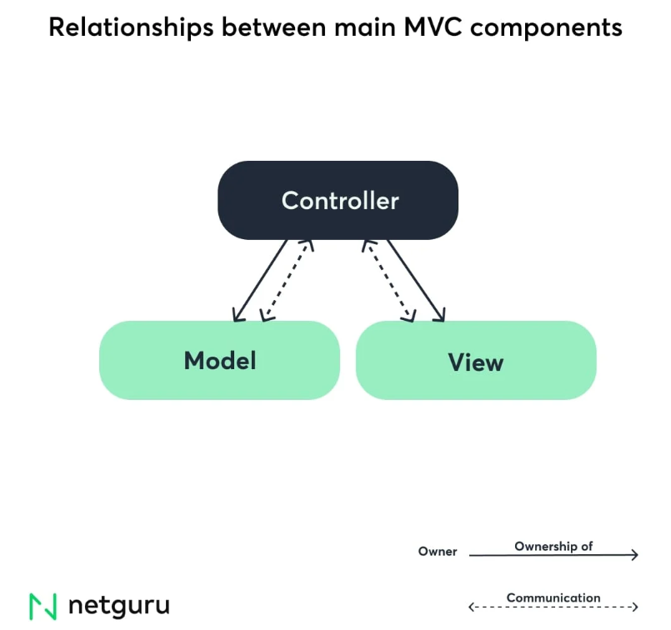

Slide 7
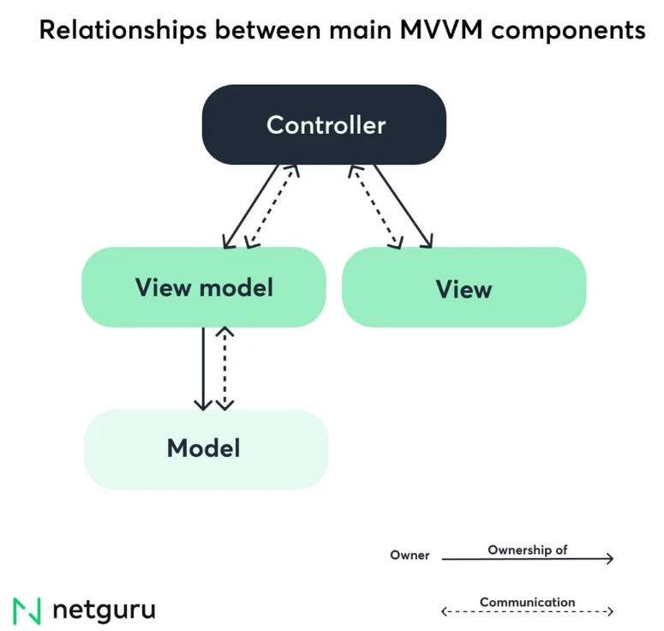
https://www.netguru.com/blog/mvc-vs-mvvm-on-ios-differences-with-examples

